Slide 1
Raising Awareness to Facilitate Beneficial Connections between Watershed Groups, Government, and Floodplain Managers.
A group project by:
Mia Goulding, Colby Gray, Erin Maloney, and Santina Wortman

Slide 2
What is a Riparian Buffer?
A natural filter strip of forest, grass, or shrub vegetation located between upland landscapes and surface waters
Can occur on one or both sides of a waterway
Provides ecological and public health services

Slide 3
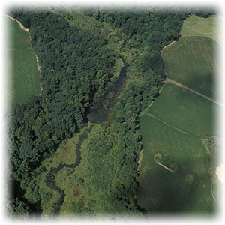
What Do Buffers Do for the Ecosystem?
Habitat Support Systems
Erosion & Pollution Control Systems

Slide 4
Habitat Support
Fish and other water creatures require some shade to control temperature.
Riparian Buffers are essential to feed, shelter, and provide travel paths for over 95% of terrestrial species in North America.

Slide 5
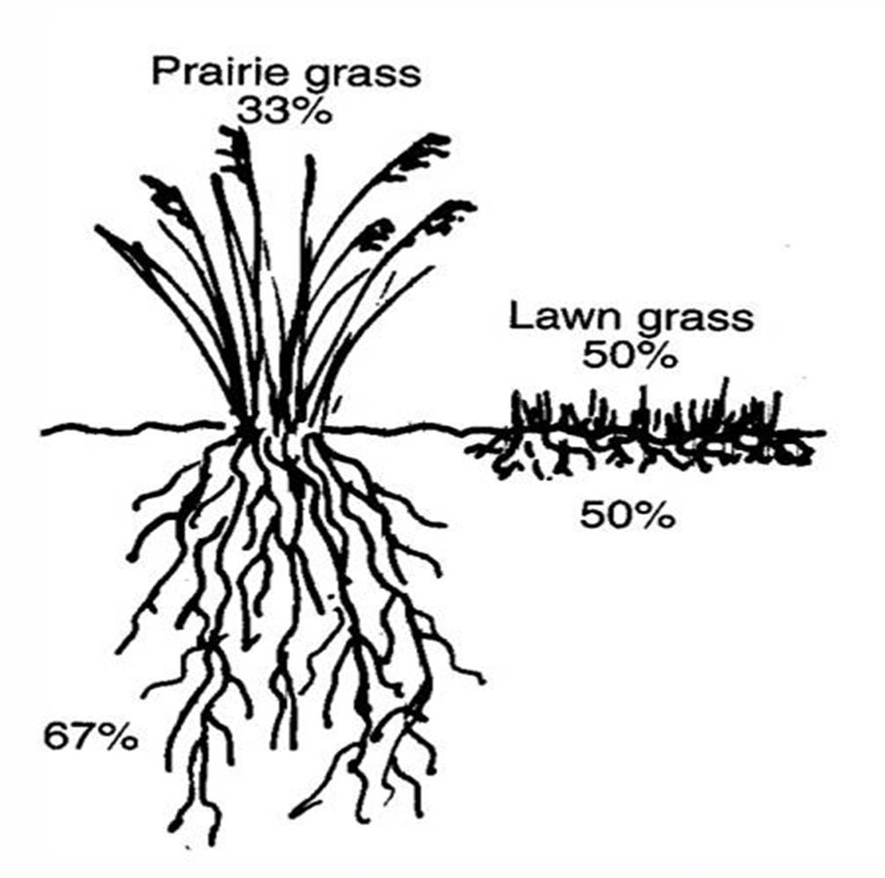
Bank Stabilization
Roots hold existing soil in place
Deep-rooted vegetation on river banks promotes meandering stream paths that move and absorb stormwater without scouring the edges.

Slide 6
Sediment Loading
Sediment is the number one pollutant found in Indiana waterways
Too much sediment smothers stream bottom habitat.
Opportunities for pathogen, nutrient, and thermal pollution increase.

Slide 7
Pathogen Loading
Septic Systems
Livestock
E. coli and other harmful pathogens become more concentrated as contaminated waters flow downstream.

Slide 8
Nutrient Loading Phosphorus & Nitrogen

Slide 9
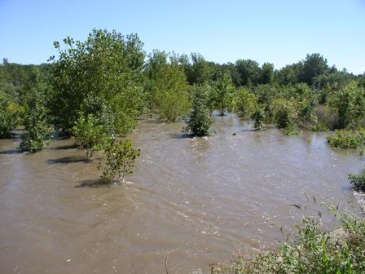
Flood Mitigation
Ecological standpoint:
Floodwater causes an increase in water quantity, and decrease in quality.
Deep root systems help guide some floodwater into the soil, and above surface plants help filter out contaminants, debris, & sediment.

Slide 10
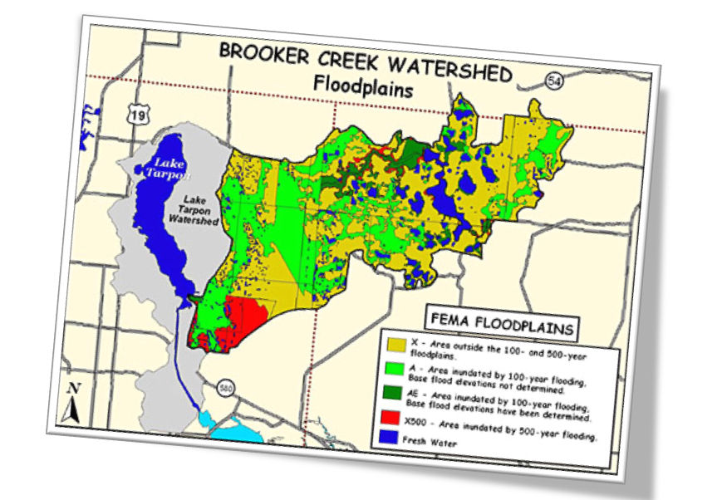
Watershed Management
Understanding how watershed protection strategies could help communities better manage their floodplains
Floodplain Management
Implementing Environmental Practices through the National Flood Insurance Program

Slide 11
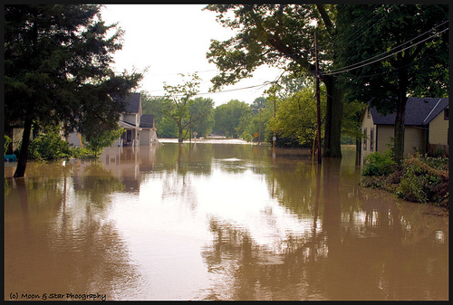
Watershed Management
Floodplain Management
GOAL
Environmental Protection/ Conservation
GOAL
Reduce Flood Risk

Slide 12
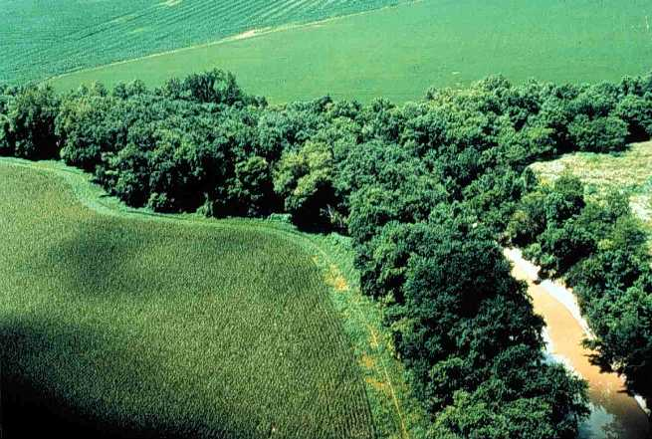
Watershed Management
Floodplain Management
Natural vegetation including riparian buffers have deep roots that allow water infiltrate
Wetlands hold large volumes of water
Reduce surface water = risk of flooding

Slide 13
Watershed Management
Floodplain Management
Watershed and Floodplain Management

Slide 14
What is the NFIP?
Two main missions:
Reducing the loss of life and property due to flooding; and
Preserving the natural and beneficial functions of the floodplain.
Voluntary Program for Communities
Must adopt and enforce a floodplain management ordinance
Enforcement area typically focused on areas mapped on Flood Insurance Rate Maps (FIRMS)

Slide 15
Flood Insurance Rate Map

Slide 16
A Program with “Teeth”
Floodplain management ordinances become enforceable regulations

Slide 17
Community Rating System (CRS)
Recognizes community efforts beyond the minimum standards
5%-45% Flood Insurance Premium Discounts
Credits Given For:
Open Space Preservation
Higher Regulatory Standards
Stormwater Management
Acquisition or Relocation
Drainage System Maintenance
Extra Credit!

Slide 18
Mutual Benefit
Floodplain Managers
Environmental Activists
Local Government

Slide 19
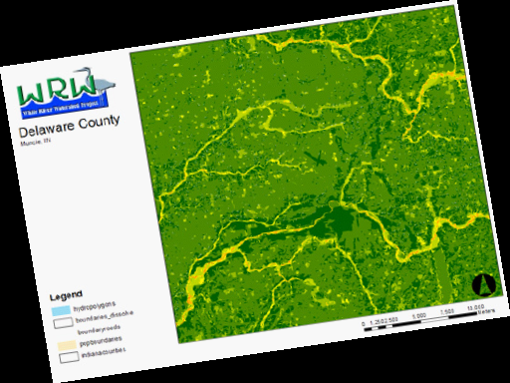
Community Based Strategies
Framing out environmental concerns along side safety issues will help to make the case for riparian buffers to wider user groups and audiences

Slide 20
A Program with “Teeth”
Floodplain management ordinances become enforceable regulations
BENEFITS of Riparian Buffers

Slide 21
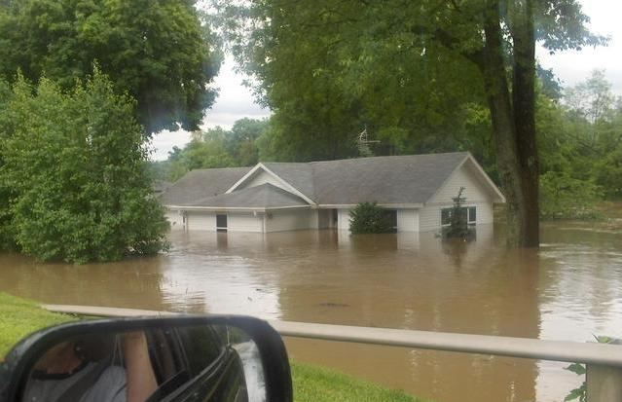
SAFETY AS A RALLYING CONCEPT

Slide 22
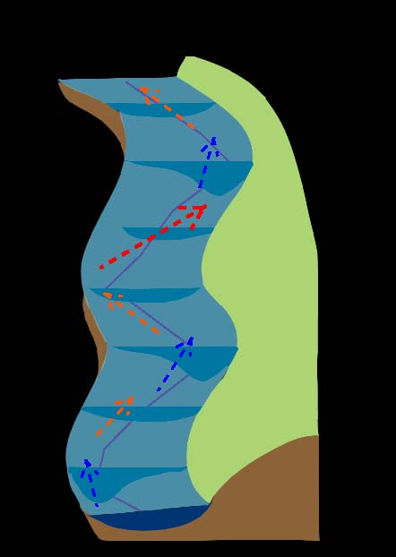
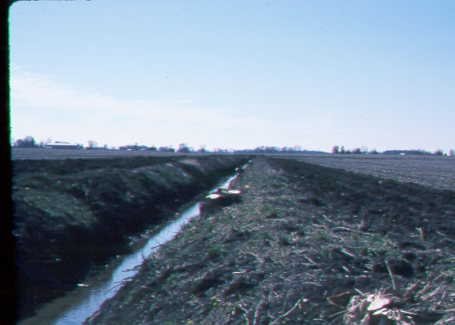
High
Pool
Moderate
Low
Transverse Bar
Riffle
Morrow’s Madows Cross Section
Pool
2. WE HAVE MANY UNSTABLE STREAMS AND THEREFORE MANY UNSTABLE FLOODPLAINS

Slide 23
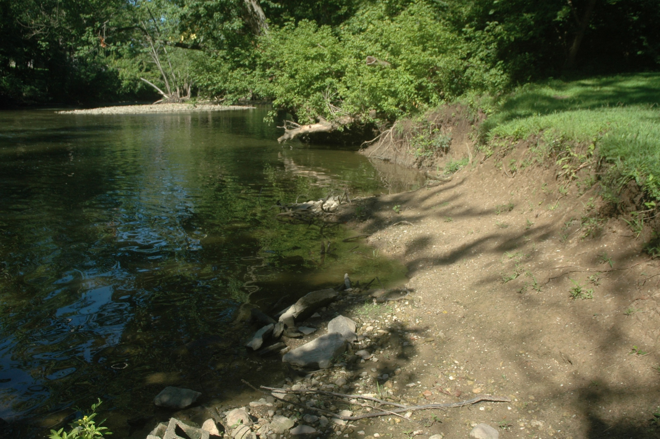
3. VEGETATION CAN HELP STABILIZE A STREAMBANK

Slide 24
Obstacles?
SAFETY AS A RALLYING CONCEPT
UNSTABLE STREAM IS AN UNSTABLE FLOODPLAIN
VEGETATION CAN HELP STABILIZE A STREAMBANK

Slide 25
Obstacles?
SAFETY AS A RALLYING CONCEPT
UNSTABLE STREAM IS AN UNSTABLE FLOODPLAIN
VEGETATION CAN HELP STABILIZE A STREAMBANK

Slide 26
OBSTRUCTIONS
Obstruction includes, but is not limited to: any dam, wall, wharf, embankment, levee, dike, pile, abutment, protection, excavation, canalization, bridge, conduit, culvert, building, wire, fence, rock, gravel, refuse, fill, structure, vegetation, or other material in, along, across or projecting into any watercourse which may alter, impede, retard or change the direction and/or
velocity of the flow of water; or due to its location, its propensity to snare or collect debris carried by the flow of water, or its likelihood of being carried downstream.

Slide 27
where:
V | is the cross-sectional average velocity (L/T; ft/s, m/s)
k | is a conversion factor of 1 (L^{1/3}/T, m^{1/3}/s for SI, or 1.4859 ft^{1/3}/s U.S. customary units, if required. Note: (1 m)^{1/3}/s = (3.2808399 ft) ^{1/3}/s = 1.4859 ft^{1/3}/s)
n | is the Gauckler–Manning coefficient, it is unitless
R_{h} | is the hydraulic radius (L; ft, m)
S | is the slope of the water surface or the linear hydraulic head loss (L/L) (S = h_{f}/L)

Slide 28
Earth | 0.025
Earth channel - clean | 0.022
Earth channel - gravelly | 0.025
Earth channel - weedy | 0.03
Earth channel - stony, cobbles | 0.035
Floodplains - pasture, farmland | 0.035
Floodplains - light brush | 0.05
Floodplains - heavy brush | 0.075
Floodplains - trees | 0.15

Slide 29
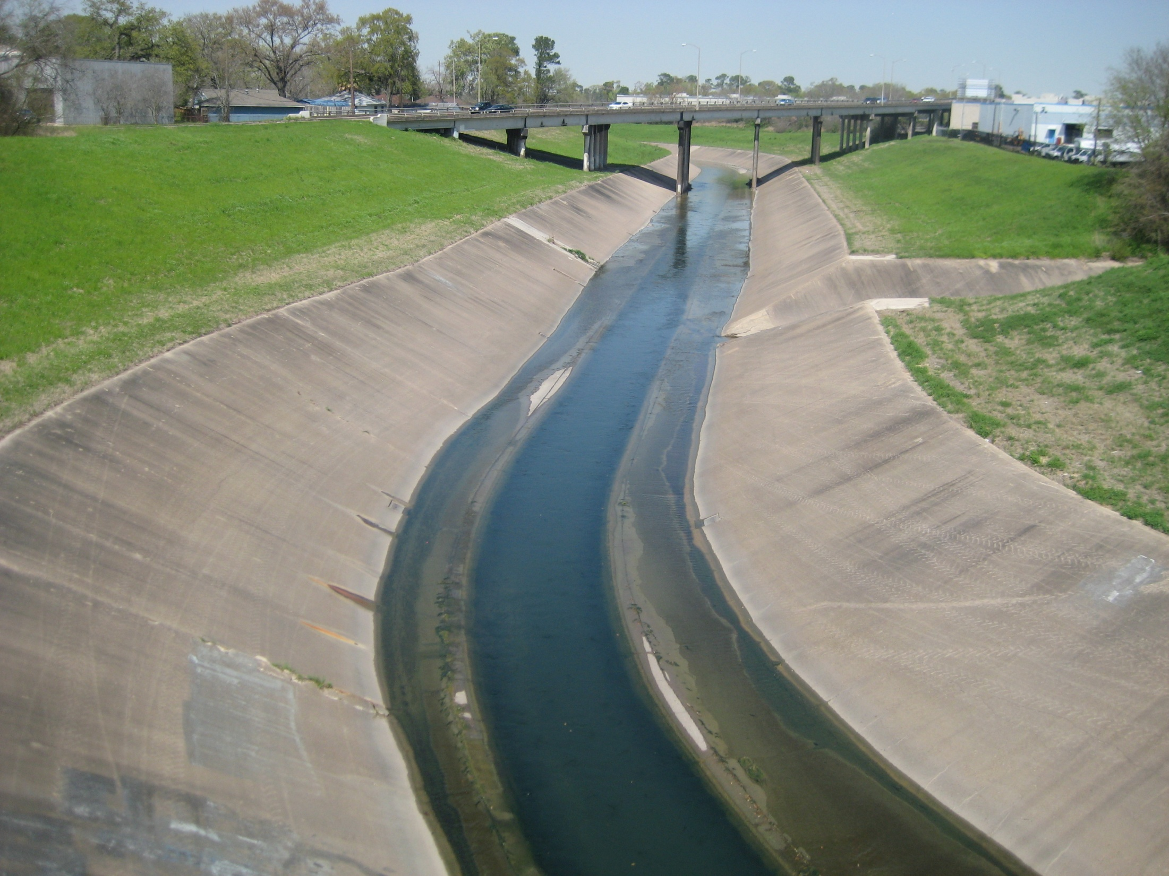

Slide 30
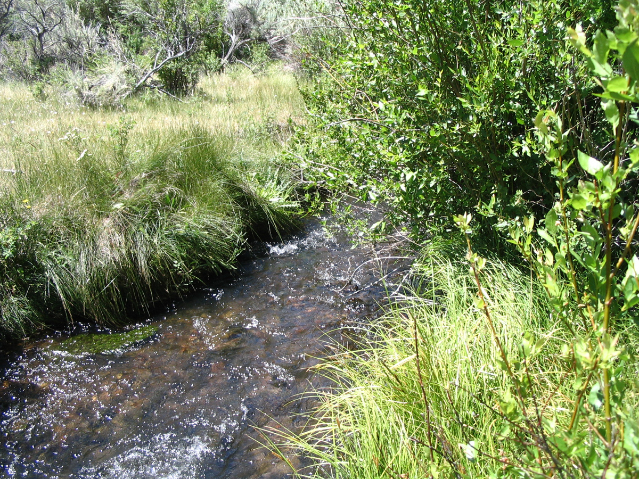

Slide 31
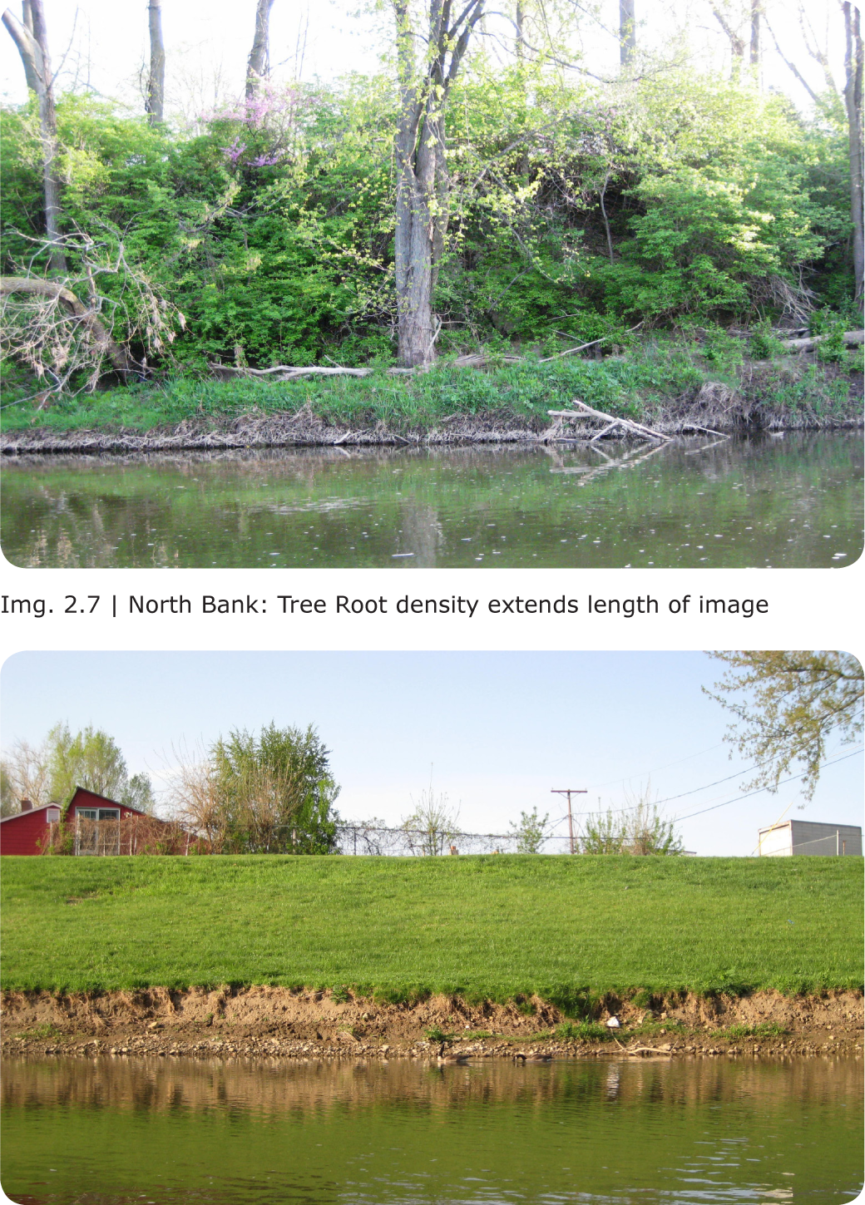
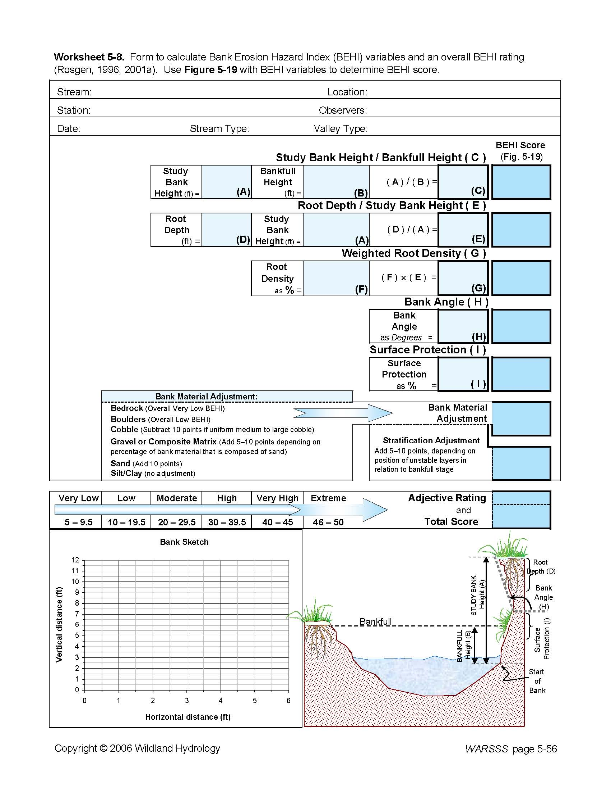

Slide 32
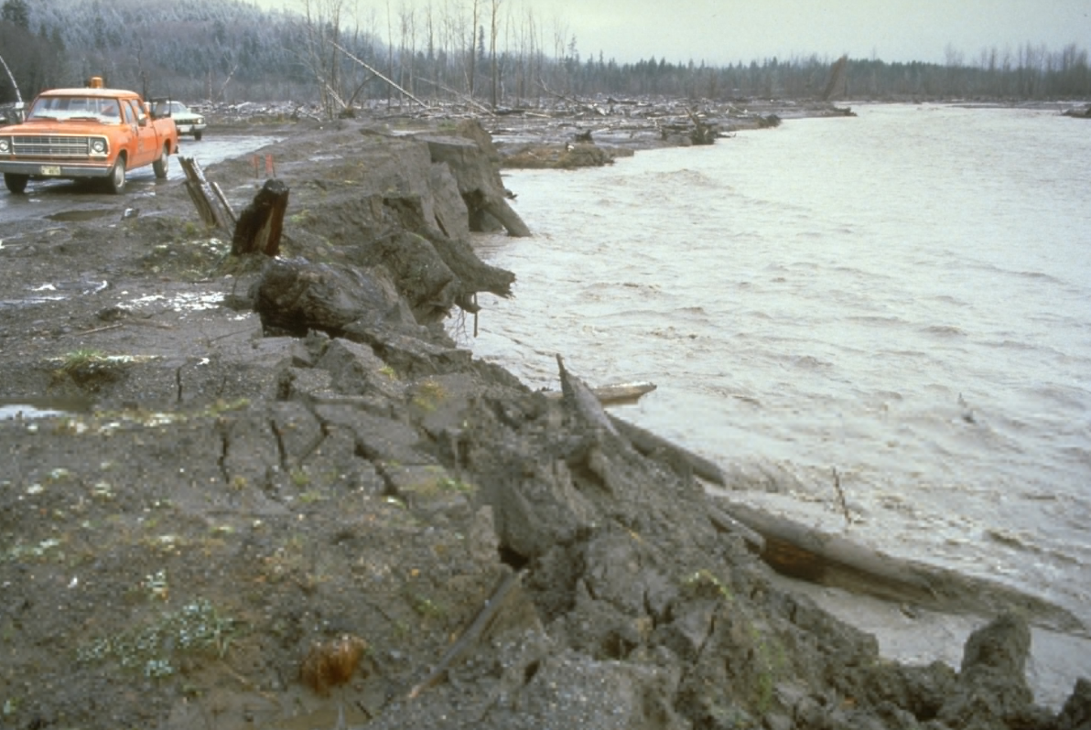

Slide 33
Concept Relationship
Erosion Hazards - an unvegetated bank is an
erosion hazard
Flood heights - increase of sediment and head cuts can raise
elevation of stream
Velocity - removal of vegetation can result in sloughing, choke channel
- incision of the channel increases velocity
Filling - localized bank failures can infill channel with areas outside floodway
Grading - aggregation, degradation
Dredging - head cuts are natures natural dredging
Alteration of natural floodplains - see parallelism

Slide 34
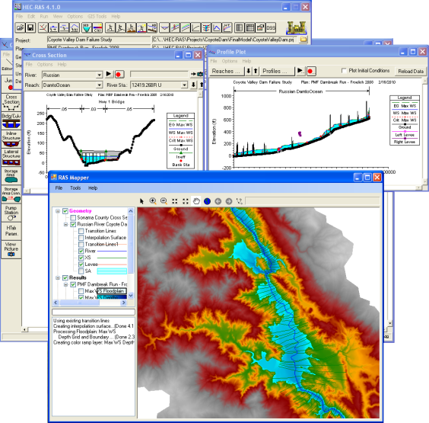
WHO IS RIGHT?

Slide 35
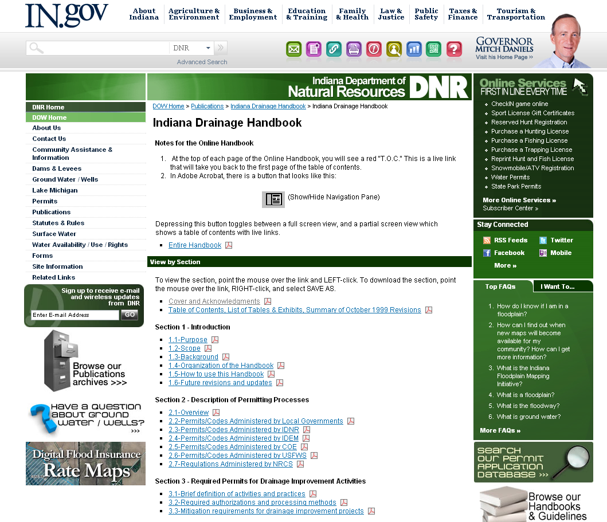
1996

Slide 36
Economic Benefits
$ 0.23* per foot per side for woody stem herbicide application every two – three years mostly one side of the bank
$0.60* per foot per foot per side for woody mulching/removal
T$3.00* per foot for trees larger than 4” or higher and escalate quickly to $20.00 or more per foot.
$25-$500 per linear foot for excavation per lineal foot
400 Miles of stream in Co.
2,000,000 ft $150,000 – Spray 1/3 Co.
$670,000 = Spray and Mulch 1/3 C0.
* Numbers from Porter County Surveyors Office, Kevin Breitzke, PE, LS

Slide 37
Environmental Benefits
Sediment is the number one impairment for fish and aquatic life
Erosion Control
Enhanced aquatic life
Shade/temperature
Nutrient Uptake
“Complete Canopy” Ground Plane, Canopy, Understory.
Tree’s growing in various stages of the process.
Indirect Benefits
Prevent loss of sediment for agricultural purposes
Increased Recreational Opportunities(fishing)
Enhanced recreational opportunities (canoe/kayak)
Increase Ground Water recharge
Ability to sell timber through sustainable management practices.

Slide 38
Loss
- Loss of farming 300’ buffer on a side of one square acre - Decrease ease of access for surveyor - remove all potential for obstructions (logjams) - “increased drainage”(however if culvert or bridges restrict anyway who cares) - “reduce long term maintenance costs”

Slide 39
Strategy
Add language requiring Handbook Specifications
Do nothing, change perception of “development”
Make case through CRS

Slide 40
1996

Slide 41
Definition of Development
Development means any man-made change to improved or unimproved real estate including but not limited to:
(1) construction, reconstruction, or placement of a structure or any addition to a structure;
(5) mining, dredging, filling, grading, excavation, or drilling operations;
(6) construction and/or reconstruction of bridges or culverts;
(8) any other activity that might change the direction, height, or velocity of flood or surface waters.
"Development" does not include activities such as the maintenance of existing structures and facilities such as painting,
re-roofing; resurfacing roads; or gardening, plowing, and similar agricultural practices that do not involve filling, grading,
excavation, or the construction of permanent structures.

Slide 42
Community Rating System (CRS)
HOW CAN WE INTEGRATE OUR LANGUAGE IN THE EXISTING MINIMUM REQUIREMENTS?

Slide 43
Stormwater Management: Regulating development through the watershed to ensure that post development runoff is no worse than pre-development and to minimize soil erosion and protect or improve water quality
Drainage System Maintenance: Conducting periodic inspections of all channels and retention basins and removing debris as needed.
Open Space Preservation: Guarantee that currently vacant floodplain parcels will be kept free from development
Extra Credit: Innovation is encouraged! Communities can apply for extra credits for activities not listed in the CRS program to determine eligibility.

Slide 44
IMPLEMNTATION

Slide 45
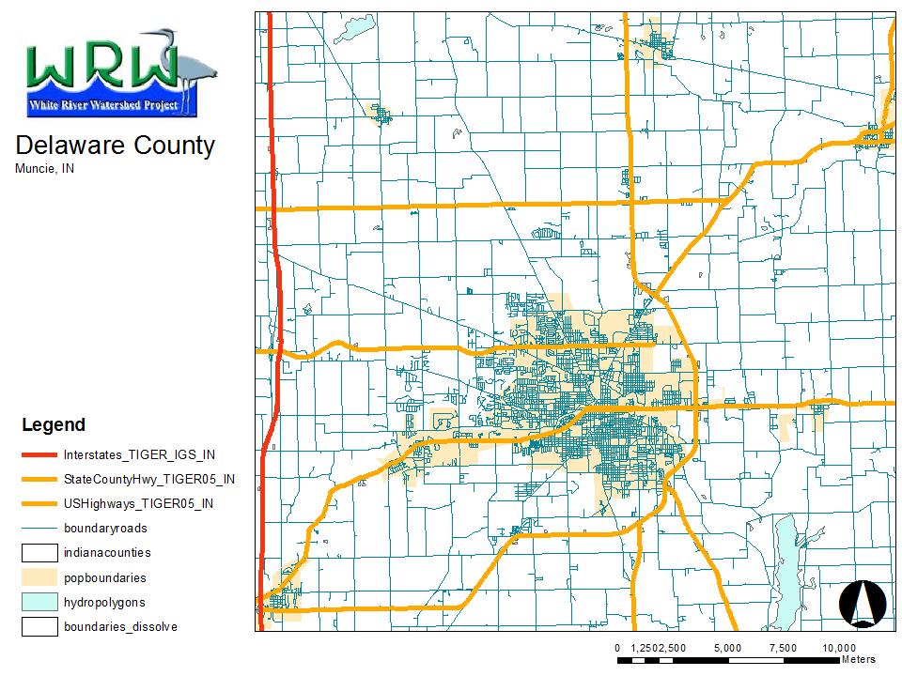

Slide 46
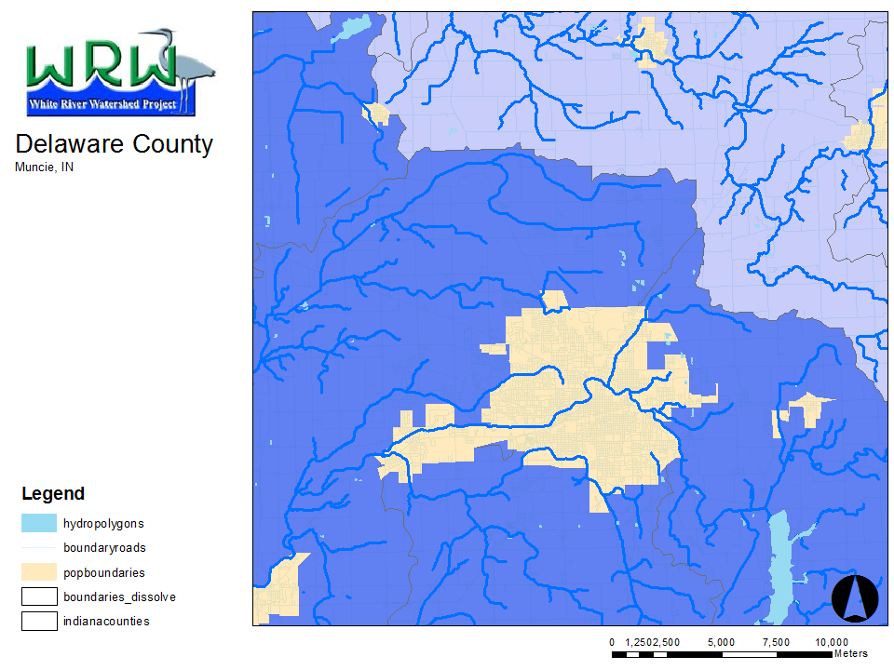

Slide 47
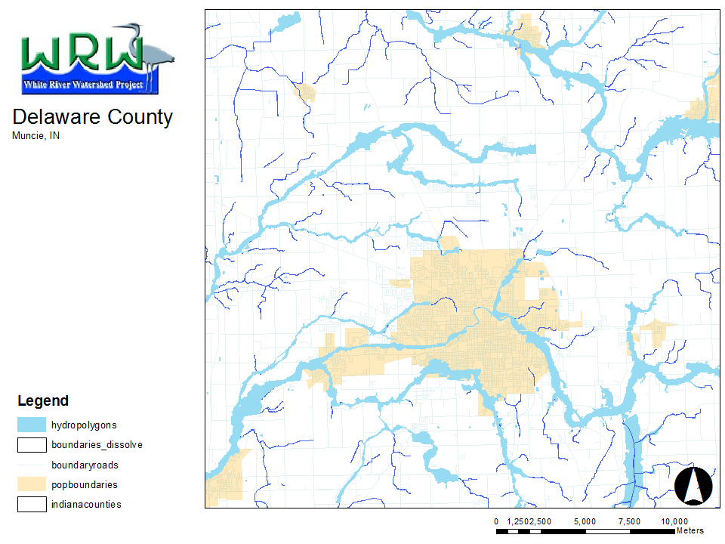

Slide 48
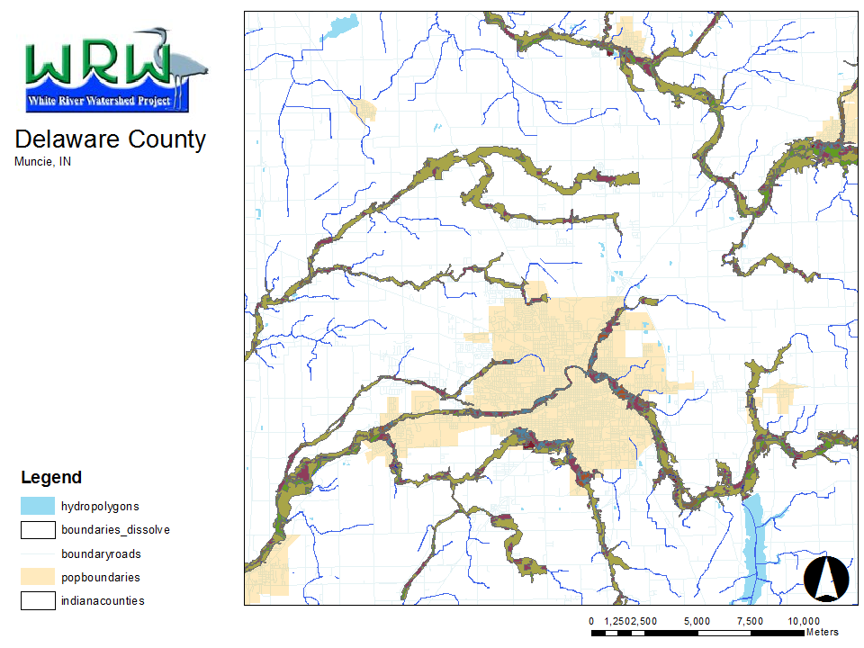
20,000 Acres Total
4,000 Vegetated

Slide 49
LIMITS / STRATEGIES

Slide 51
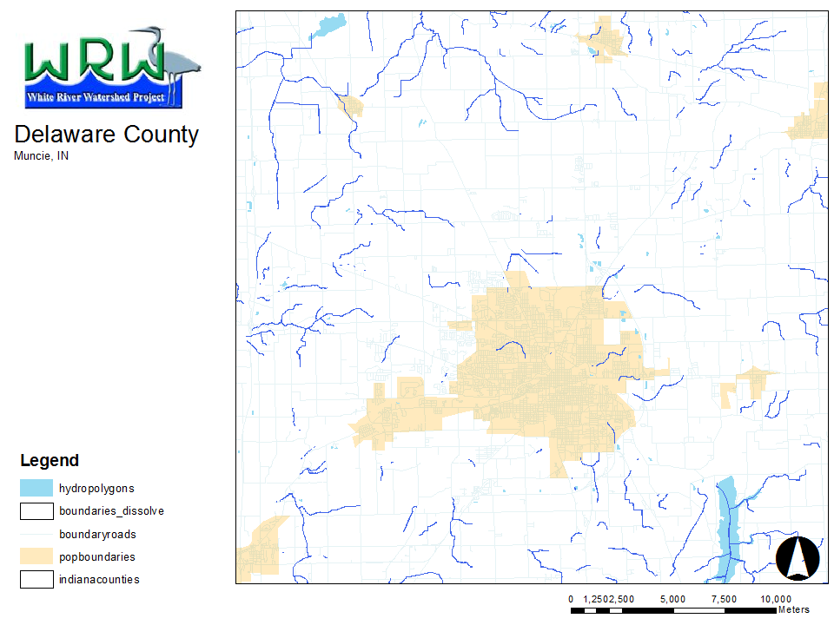

Slide 52
REZONING
Go before planning commission
Make proposal to planning commission Go before City Council, Go before County Council 3 month process

Slide 53
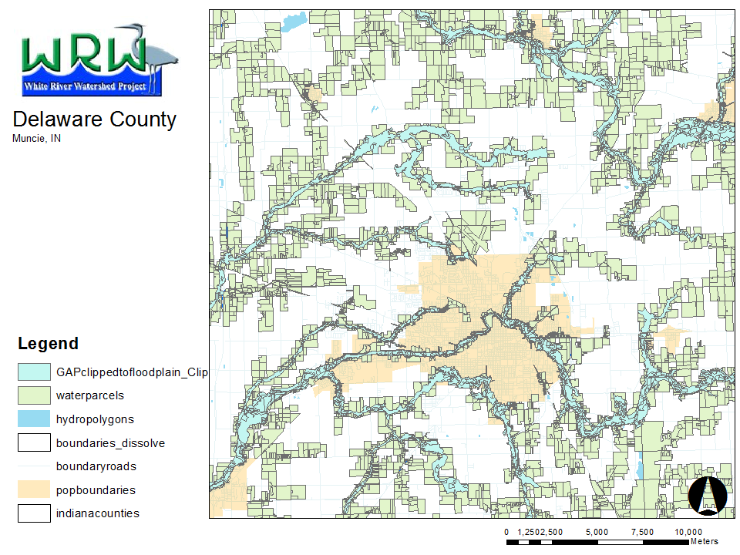
7,800 Parcels

Slide 54
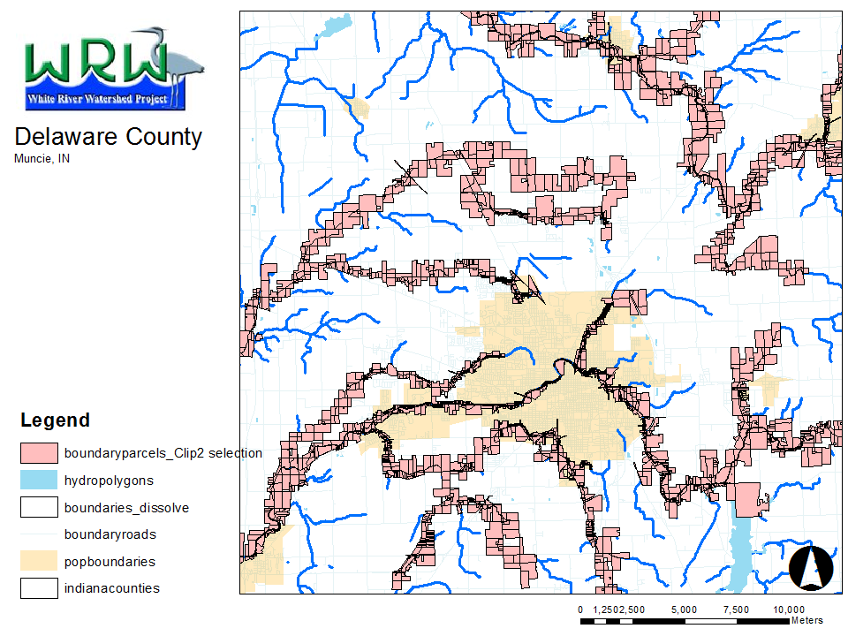
3,800 Parcels

Slide 55
OVERLAY
ZONE

Slide 56
Language from Baltimore County, MD Includes specific language specifying the expansion of buffers for erodible soils and steep slopes.
WordPerfect Format (693KB, 10pages) PDF Format (167KB, 12pages).
Rhode Island Coastal Zone Program An example of a buffer ordinance in a coastal region.
WordPerfect Format (204KB, 11pages) PDF Format (36KB, 11pages).
Ordinance on Riparian Habitat Areas, Napa, CA A buffer ordinance for a region with few native trees. This ordinance focuses on the preservation of other native vegetation.
WordPerfect Format (14KB, 2pages) PDF Format (10KB, 2pages).
Portland Metro Floodplain Preservation Ordinance Focuses on management of the floodway.
WordPerfect Format (14KB, 4pages) PDF Format (16KB, 4pages).
Model Land Trust Agreement (Natural Lands Trust) An example of a land trust agreement. Such documents are often needed to ensure the long-term integrity of the buffer
WordPerfect Format (51KB, 11pages) PDF Format (32KB, 11pages).
http://www.epa.gov/owow/NPS/ordinance/buffers.htm

Slide 57
Target Parcels
ZONING CONSERVASTION EASEMENTS FEDERAL /STATE PROGRAMS OTHER OPPORUNITIES

Slide 58
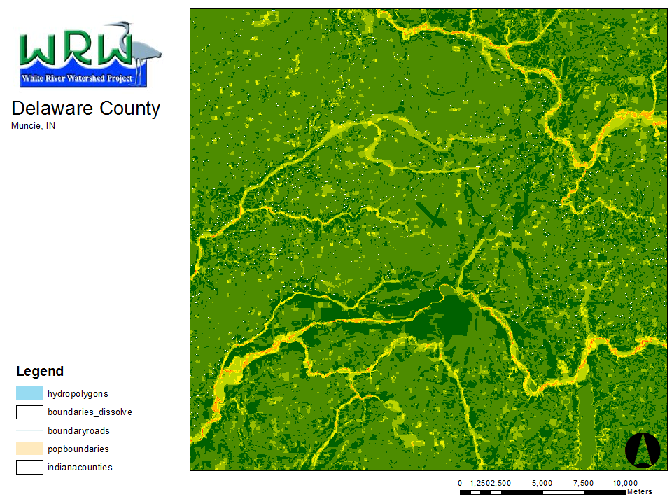
HYDRO FLOODPLAIN WETLAND SOILS WOODED SLOPE

Slide 59
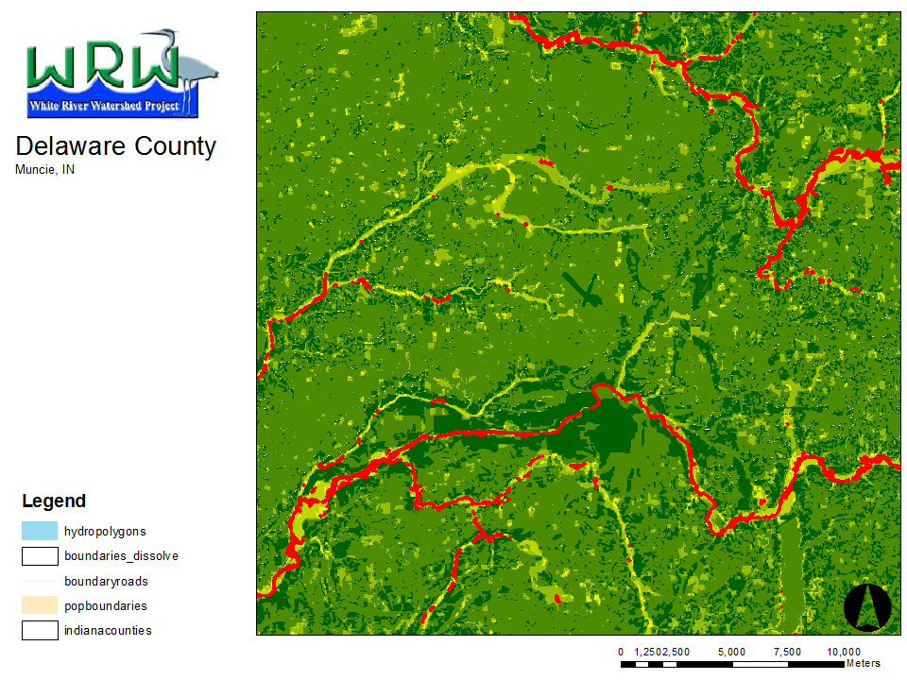

Slide 60
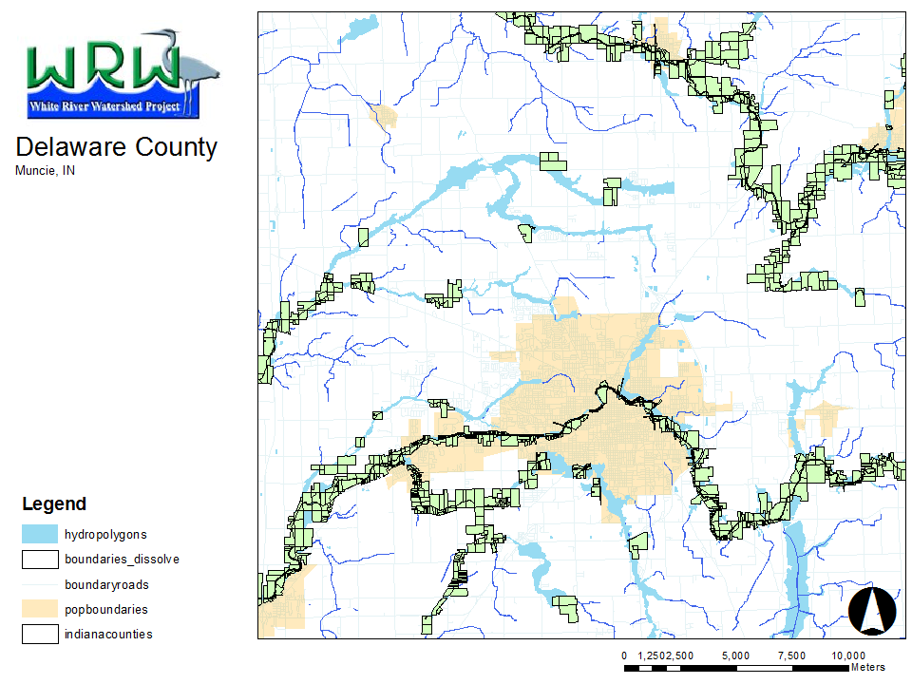
2,050 Parcels

Slide 61
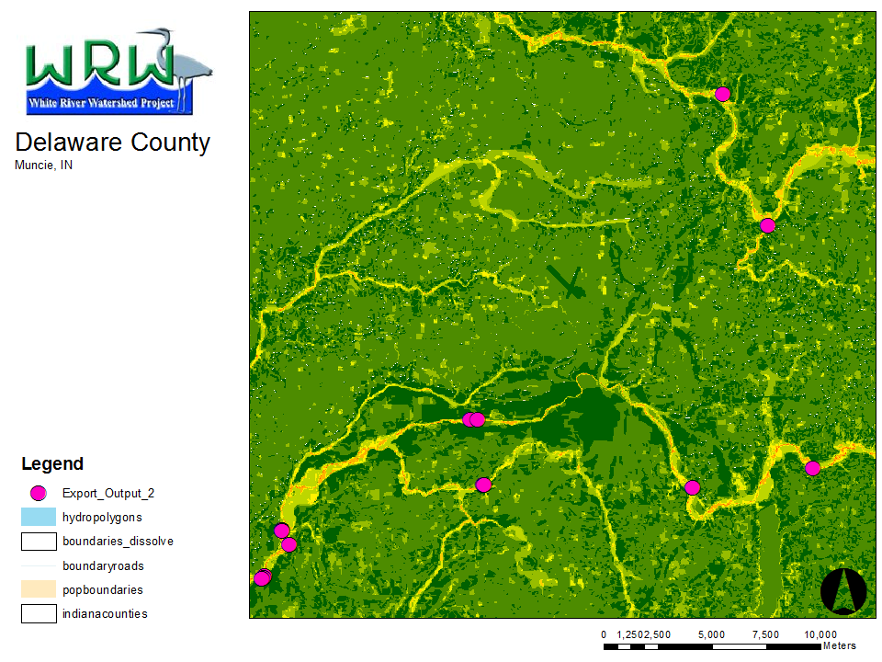
13 Parcels

Slide 62
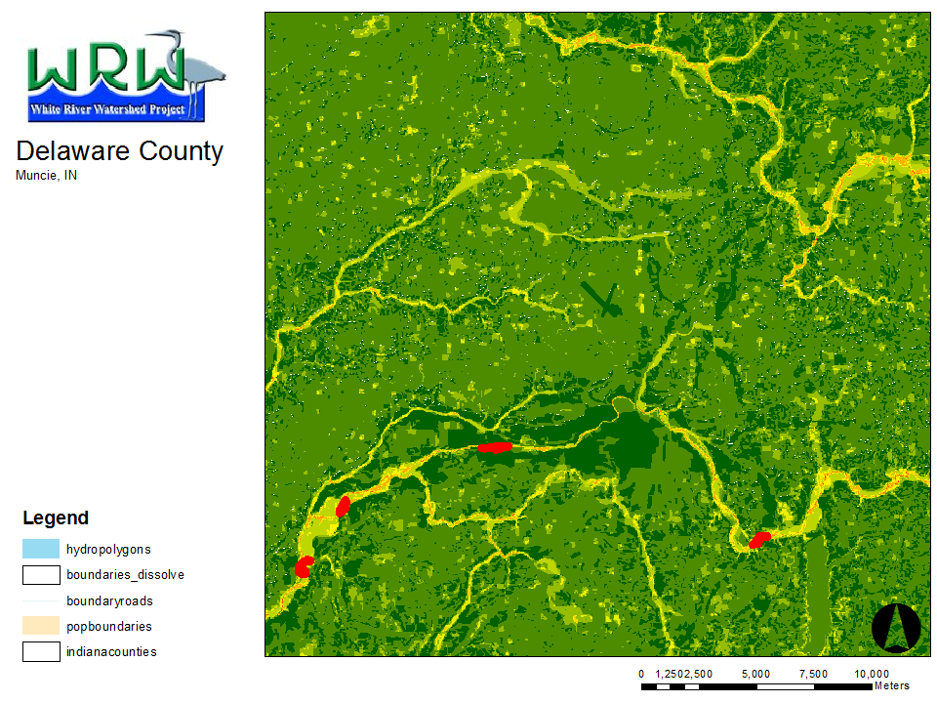
4 Parcels

Slide 63
SAFETY AS A RALLYING CONCEPT
UNSTABLE STREAM IS AN UNSTABLE FLOODPLAIN
VEGETATION CAN HELP STABILIZE A STREAMBANK
ZONING/ ORDINANCES TOOL
THROUGH FEMA/”SAFETY LANGUAGE” GAIN ENV. BENEFITS

Slide 64
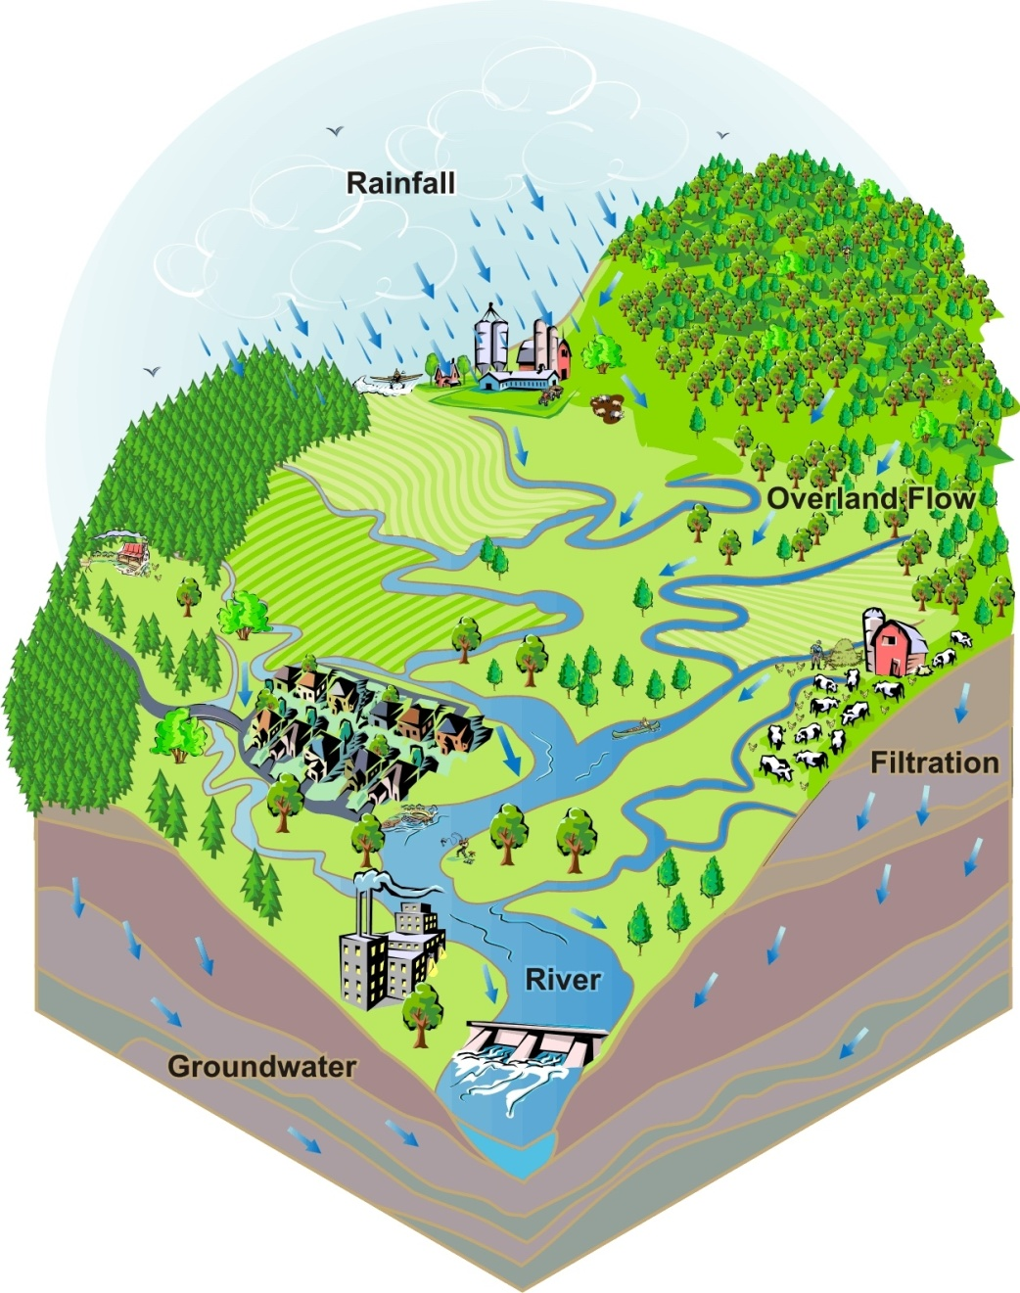
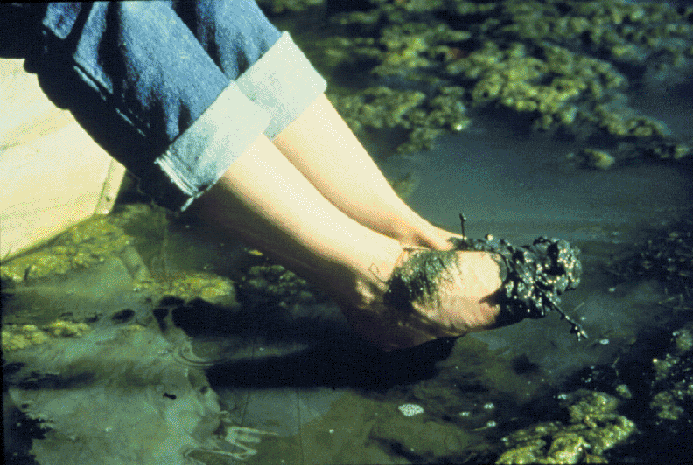
Remember: No Matter Where You Live, Work, or Play, its in a Watershed.
Riparian Buffers are just one way we can manage our runoff, improve our surface waters, and increase our overall quality of life.
Future generations don’t have to swim, fish, or play in unsightly, unhealthy waters.

